Slide 1

MERN Stack Powered By Mongodb
A Book Store Application Using MERN Stack
LOYOLA – ICAM COLLEGE OF
ENGINEERING AND TECHNOLOGY (LICET)
LOYOLA CAMPUS, NUNGAMBAKKAM , CHENNAI – 34
DEPARTMENT OF INFORMATION TECHNOLOGY
Team Members Register Number
Jeevaregai Shanmugam 311121205025
Varshini G 311121205061
Allan Thiyagaseelan 311121205007
Allan Gabrial 311121205006
Anthony George Agil 311121205009

Slide 2
Abstract
The E-Book Store application is a versatile and intuitive platform designed to streamline the browsing, purchasing, and management of books, catering to both customers and administrators through a dual-login system. For customers, the platform offers a seamless and responsive user experience, allowing them to explore a comprehensive catalog, add books to their cart, and complete transactions effortlessly.
Administrators benefit from a robust management interface with CRUD functionality, enabling them to add new books, update existing records, and delete outdated entries, ensuring the catalog remains accurate and up-to-date.
Built with a focus on secure data handling, scalability, and responsive design, the system provides a modern, efficient solution that enhances user satisfaction and simplifies inventory management. By integrating functionality and usability, the E-Book Store application serves as a comprehensive and adaptable tool for the needs of contemporary bookstores.

Slide 3
Introduction
Books have long been essential for knowledge and leisure, but traditional methods of purchasing and managing them often face challenges like limited accessibility and inventory inefficiencies. This project addresses these issues with a dual-login Bookstore Management System tailored for customers and administrators.
Customers enjoy a seamless shopping experience with features like book browsing, cart management, and easy checkout. Administrators are empowered to manage inventory effectively through tools for adding, updating, and deleting books.
By streamlining operations and enhancing accessibility, this system meets the growing demand for efficient, real-time solutions in the book retail sector, benefiting both readers and bookstore owners.

Slide 4
Objective
To provide customers with an intuitive platform to browse, add books to a cart, and complete purchases seamlessly.
To enable administrators to efficiently manage the book inventory through CRUD operations.
To ensure real-time data accuracy for book availability and system operations.
To design a scalable and secure system to handle growing user demands and ensure data integrity.
To enhance the user experience by offering features like top-selling books and genre-based browsing for easier book discovery.

Slide 5
Existing System
Challenges Faced by Existing Systems
Poor User Experience: Existing systems may lack intuitive interfaces, making it difficult for customers to browse and purchase books easily.
Inefficient Inventory Management: Admins face challenges in manually updating and maintaining an accurate book catalog.
No Real-Time Updates: Lack of real-time data causes discrepancies in book availability and cart status.
Security Issues: Inadequate login systems and data management can compromise user data and inventory security.

Slide 6
Proposed System
The E-Book Store application provides the following solutions:
Users can easily browse books by genre and top sellers, with a smooth cart and checkout process.
Admins can efficiently manage book listings through CRUD operations.
Book availability, cart status, and orders are updated in real-time.
Secure login for both users and admins ensures data protection.
Users can view top-selling books and browse by genre for easier discovery.
MongoDB provides flexible, scalable, and efficient data management.
Users can add, update, and remove items in their cart, streamlining the purchase process.

Slide 7
System Specifications
Hardware Requirements
Server:
Processor: 2 GHz dual-core (minimum); quad-core (recommended).
RAM: 4 GB (minimum); 8 GB (recommended).
Storage: 20 GB (minimum); 50 GB+ (recommended).
Internet: Stable connection with sufficient bandwidth.
Client:
Device: Any modern computer, tablet, or smartphone.
Browser: Supports JavaScript and HTML5 (e.g., Chrome, Firefox, Safari, Edge).
Internet Speed: Minimum 2 Mbps download.
Software Requirements
Frontend:Framework: React.js
Backend:Runtime: Node.js Express.js
Database: MongoDB

Slide 8


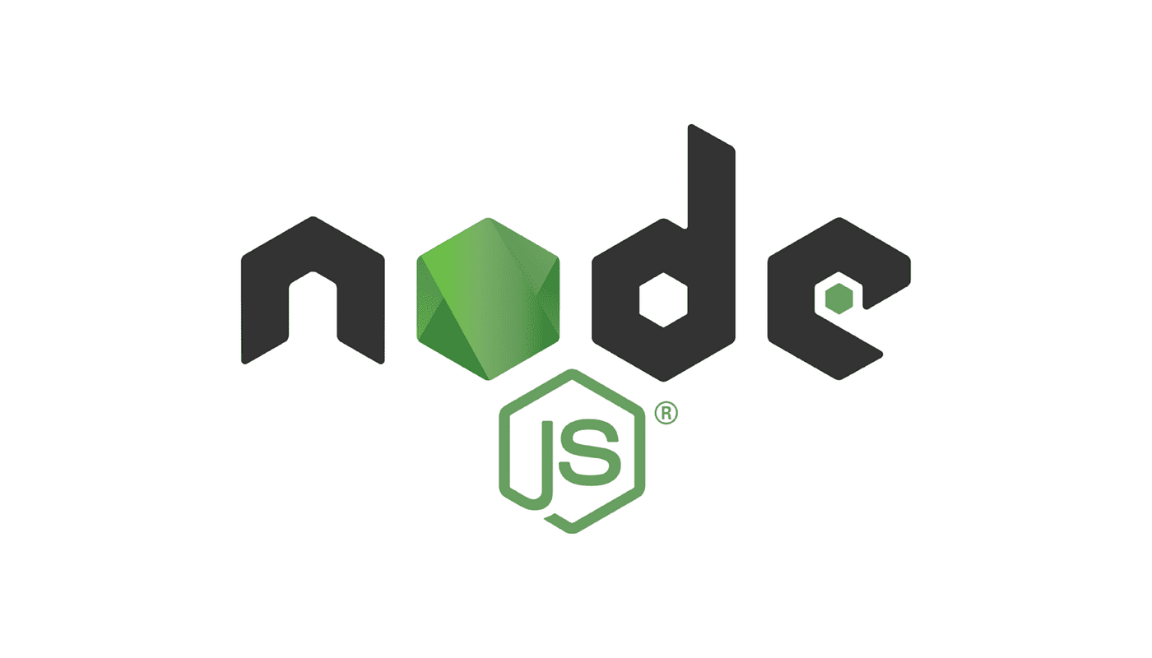
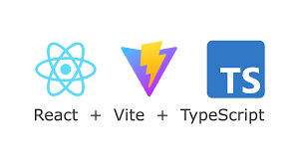
Software Specification
MERN Stack:
MongoDB: NoSQL database for storing and managing book records.
Express.js: Backend framework for building RESTful APIs and handling server-side logic.
React (with Vite): Frontend library for creating an interactive user interface, using Vite as a fast development build tool.
Node.js: JavaScript runtime for running server-side applications.
Vite: A modern build tool for faster and optimized React app development.
UI Framework:Tailwind CSS, Material-UI, or Bootstrap for styling
Development Tools: npm/yarn for package management , Git for version control ,Postman for API testing

Slide 9

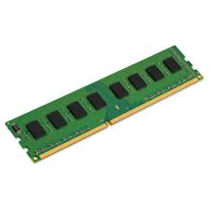
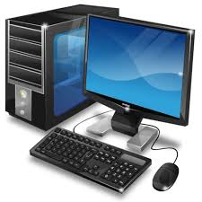

Hardware Specifications
Server Requirements:
Processor: Minimum 2 GHz dual-core
RAM: 4 GB or more
Storage: At least 20 GB
Client Requirements:
Device: Desktop, laptop, or mobile with modern browser support
Internet: Stable connection of at least 5 Mbps

Slide 10
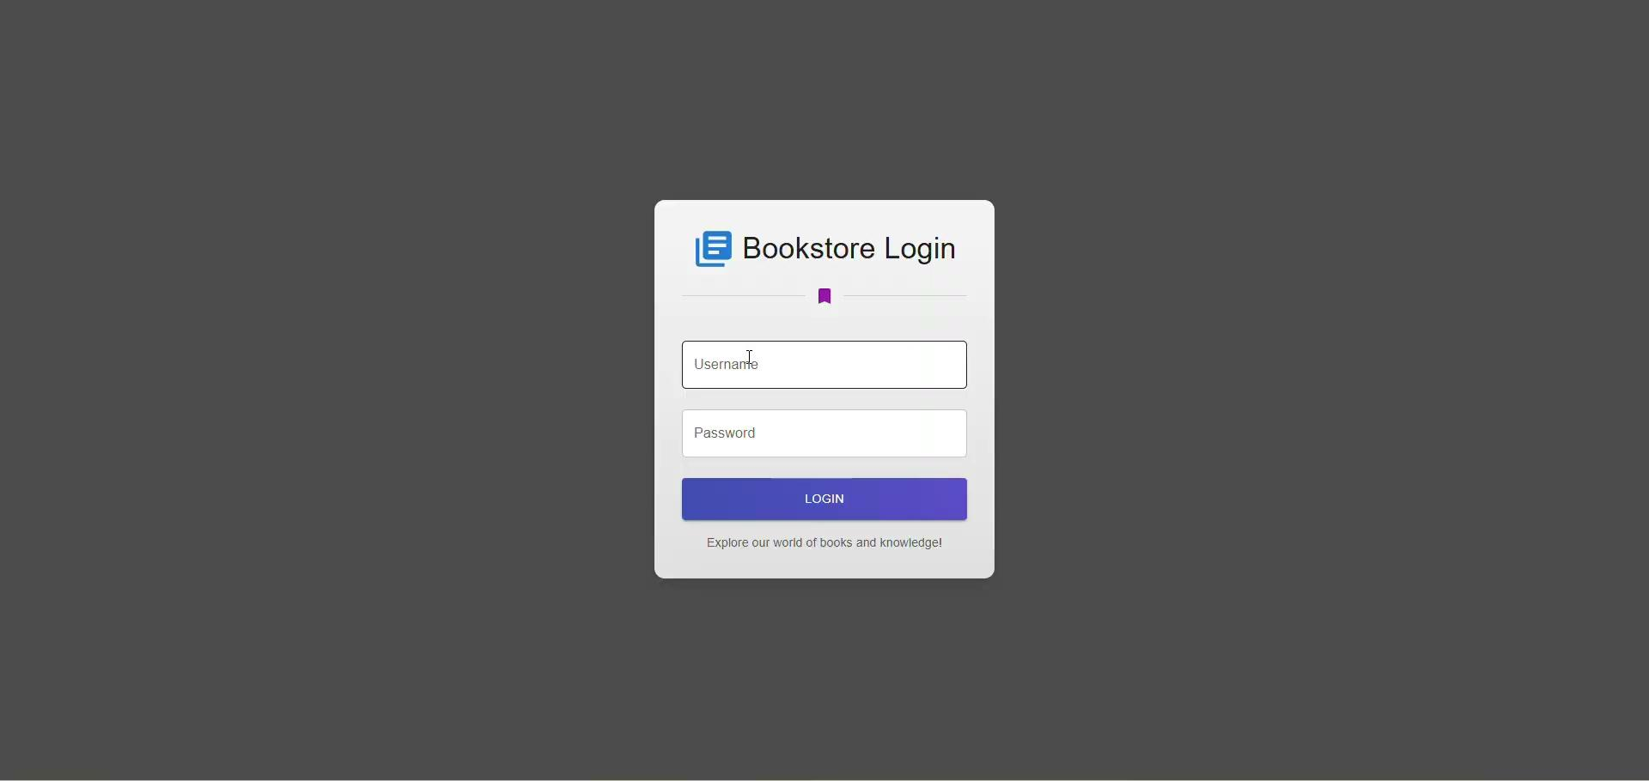
Demo Video

